Slide 1
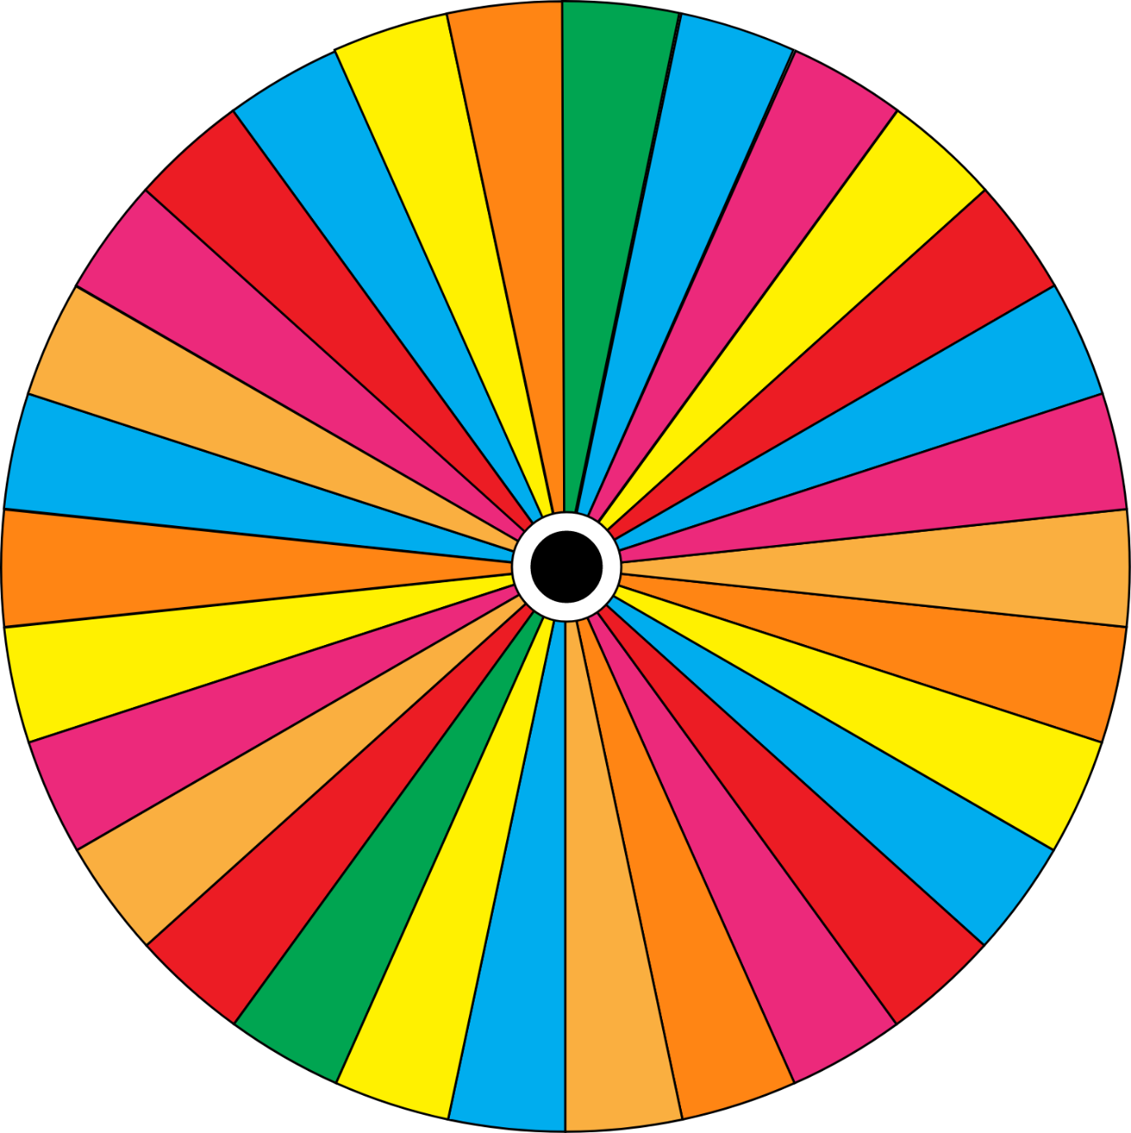
Verb Tenses Wheel
https://whatistheurl.com
Print, cut and fix the small piece in the center of the wheel using a pin. Spin the wheel and the student makes up on original sentence in the tense you want to practice.
USE
ASK
ADD
https://whatistheurl.com
TURN
WORK
CALL
WALK
COLLECT
VISIT
BLINK
TRAIN
CARRY
TALK
CONTAIN
STOP
DESTROY
SMELL
DREAM
SAVE
ENJOY
RECEIVE
EXPLAIN
PRESS
FEAR
OFFER
FIX
MIX
FIND
JOIN
https://whatistheurl.com
INFORM
Please visit our site for worksheets and charts https://whatistheurl.com/

